Slide 1
Ch.6 Descriptive Statistics (기술통계학)
Updated: November 15, 2016
Choi, Kwanghoon
Dept. of Electronics and Computer Engineering
Chonnam National University

Slide 2
6.1 Descriptive Statistics(기술통계학)
Statistics(통계학)
A study of the collection, analysis, interpretation, and presentation of data.
Census(전수조사) | Sample Survey(표분조사)
Population(모집단) | Sample(표본)
Descriptive Statistics (기술통계학) => Ch.6 | Inferential Statistics (추측통계학) => Ch. 7,8,9

Slide 3
This Lecture
Descriptive statistics (기술 통계학)
Data Presentation (6.2 자료의 정리)
Sample Statistics
Measure of Points (6.3 위치 척도)
Measure of Dispersion (6.4 산포의 척도)

Slide 4
6.2 Data Presentation (자료의 정리)
Data(자료)
Quantitative Data
(양적자료)
Continuous Data
(연속자료)
Discrete Data
(이산자료)
Qualitative Data
(질적자료)

Slide 5
6.2 Data Presentation (자료의 정리)
Dot plot (점도표)
Frequency table (도수 분포표)
cf. Rank-based FT (집단화 자료의 도수 분포표)
Bar chart (막대 그래프)
cf. Pareto chart (파레토 그림)
Line graph (선 그래프)
Pie chart (원 그래프)

Slide 6
6.2 Data Presentation (자료의 정리)
Histogram (히스토그램)
Frequency Polygon (도수분포다각형)
Stem-leaf display (줄기-잎 그림)
Scatter diagram (산점도)

Slide 7
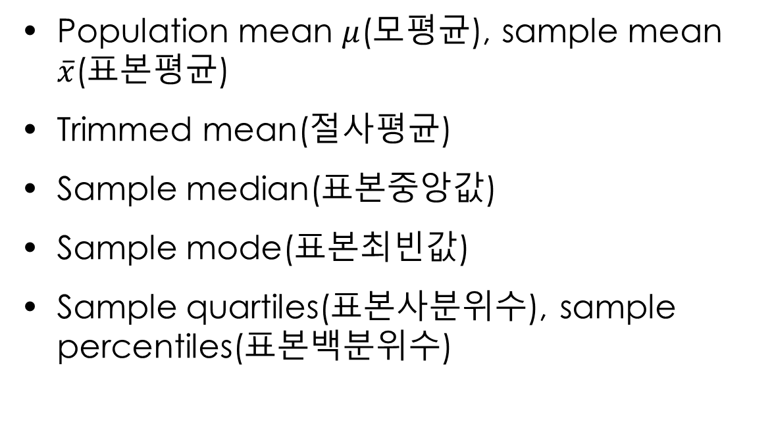
6.3 Measure of Points(위치의 척도)
Population mean $μ$(모평균), sample mean $\overline{x}$(표본평균)
Trimmed mean(절사평균)
Sample median(표본중앙값)
Sample mode(표본최빈값)
Sample quartiles(표본사분위수), sample percentiles(표본백분위수)

Slide 8
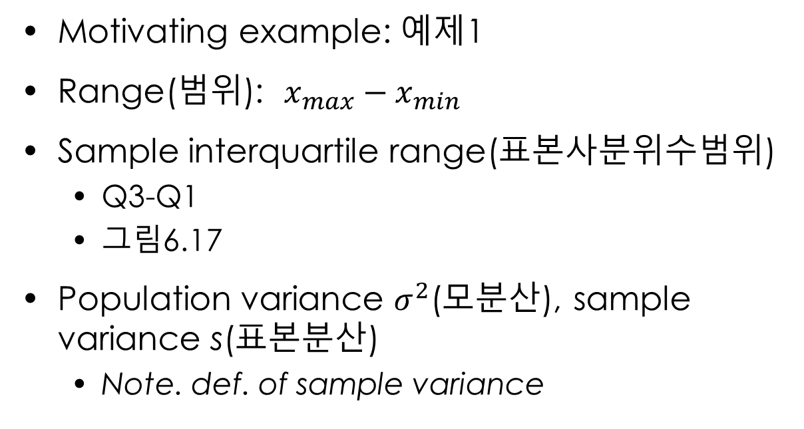
6.4 Measure of Dispersion(산포의 척도)
Motivating example: 예제1
Range(범위): $x_{max}−x_{min}$
Sample interquartile range(표본사분위수범위)
Q3-Q1
그림6.17
Population variance $σ^{2}$(모분산), sample variance s(표본분산)
Note. def. of sample variance

Slide 9
6.4 Measure of Dispersion(산포의 척도)
Measure of relative dispersion
Coefficient of variation(변동계수) – 예제5
z-score (cf. 그림6.18, 6.19)

Slide 10
What we have learned
Many effective ways of data presentation

